Slide 1



DATA PROCCESING
Tomás Ruiz Penin

Slide 2

2.1 Initial Setup and Loading Data
2.1 Initial Setup and Loading Data
Before uploading the dataset to hadoop, I converted the file to have tabs as separator instead of commas, due to the fact that PySpark didn´t seem to process the columns correctly with the original. So “lyrics-data.csv” was converted to “lyrics-dataTAB.csv” with the same size and data.

Slide 3
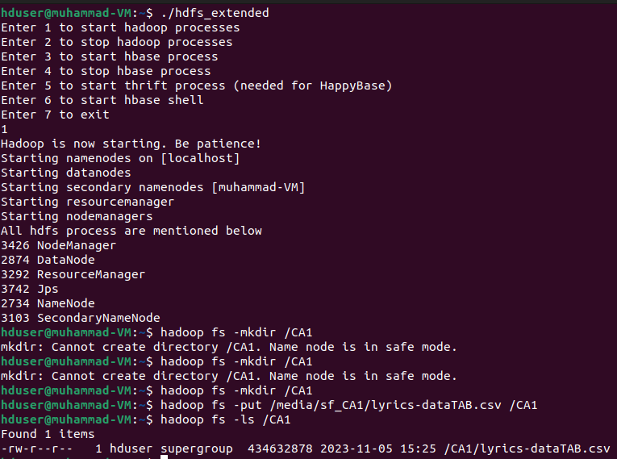

Slide 4
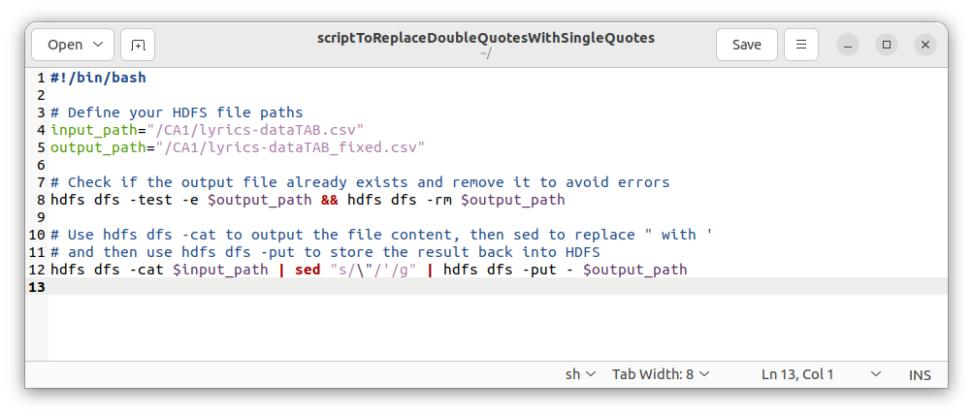

Slide 5
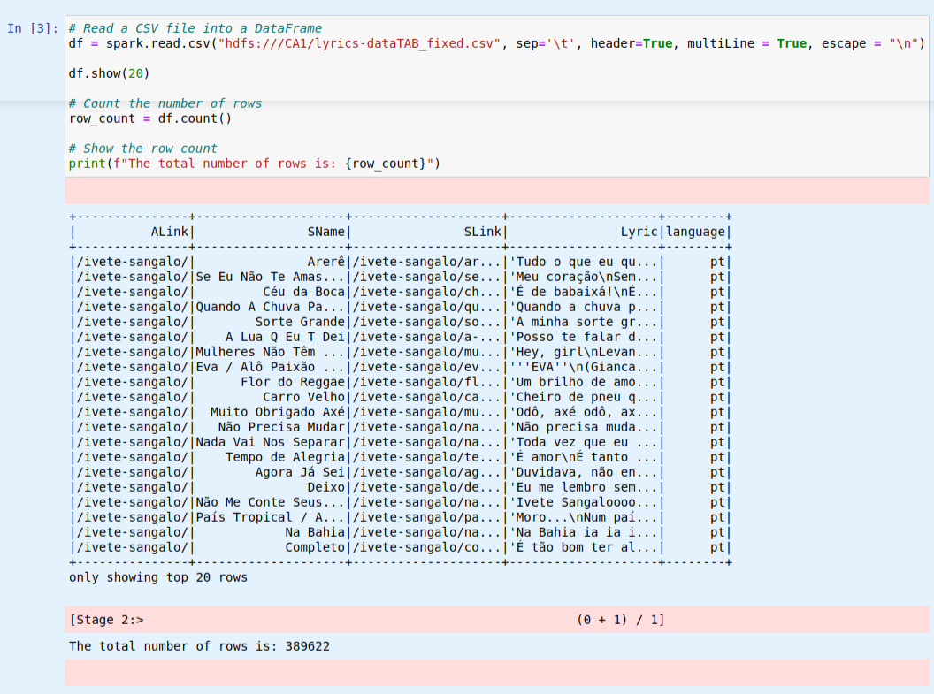

Slide 6
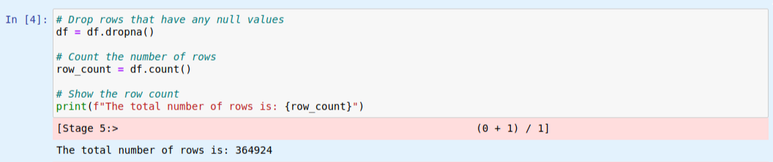

Slide 7
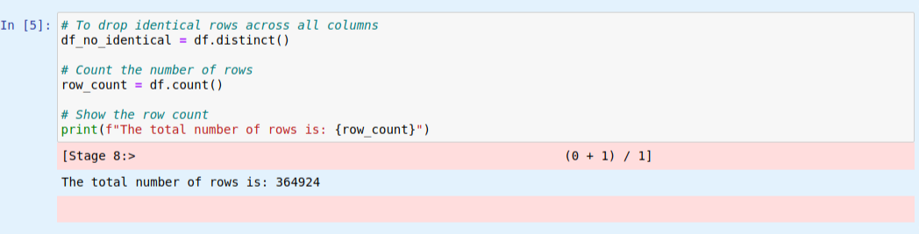

Slide 8
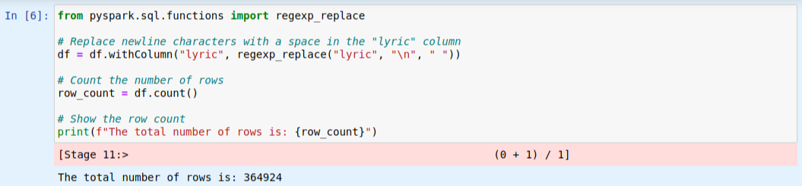

Slide 9
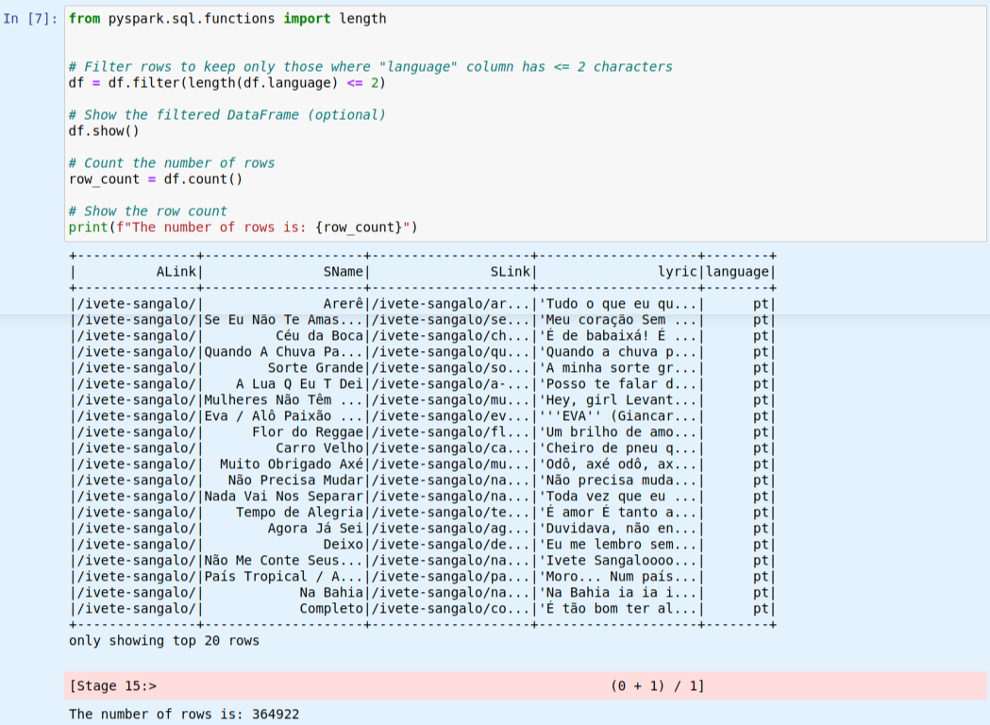

Slide 10
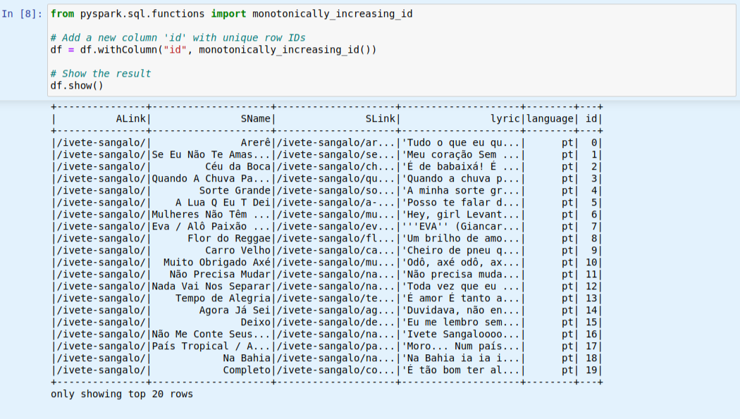

Slide 11
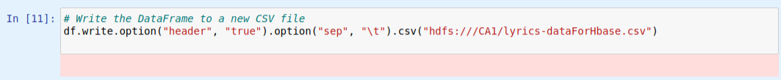

Slide 12
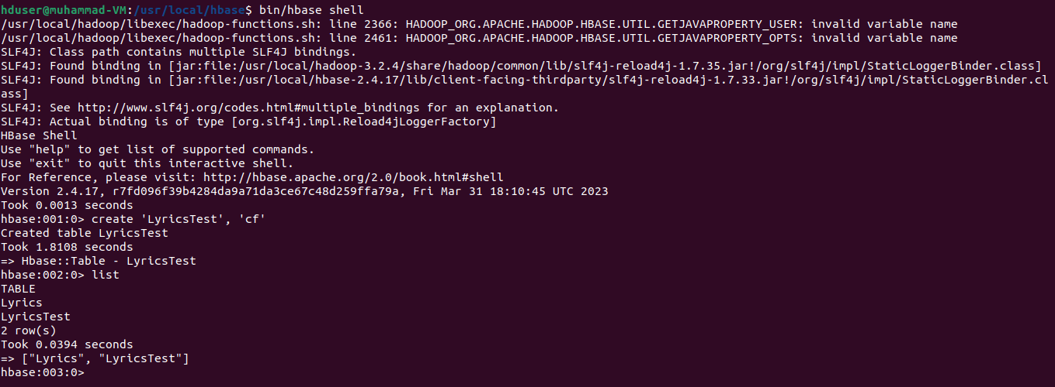

Slide 13
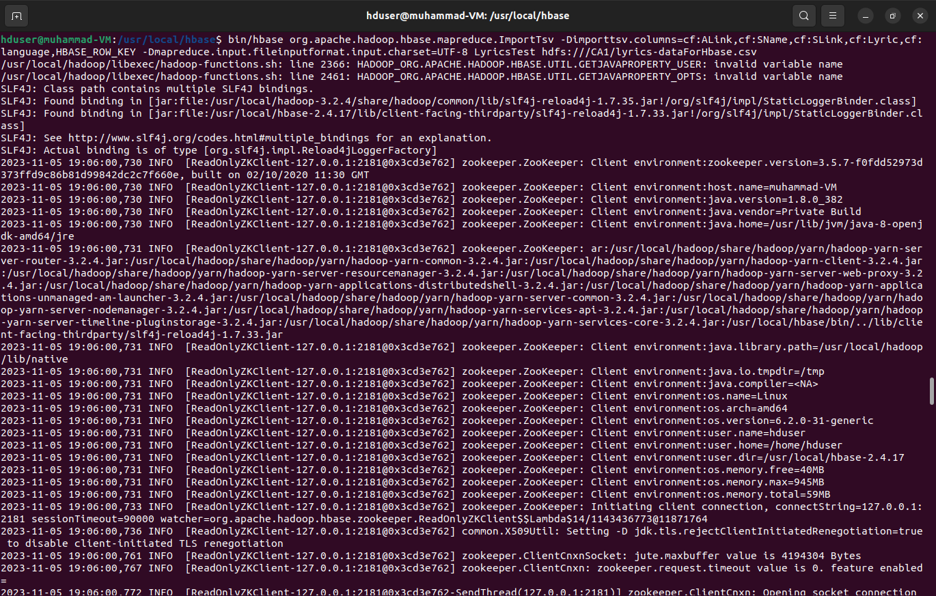

Slide 14
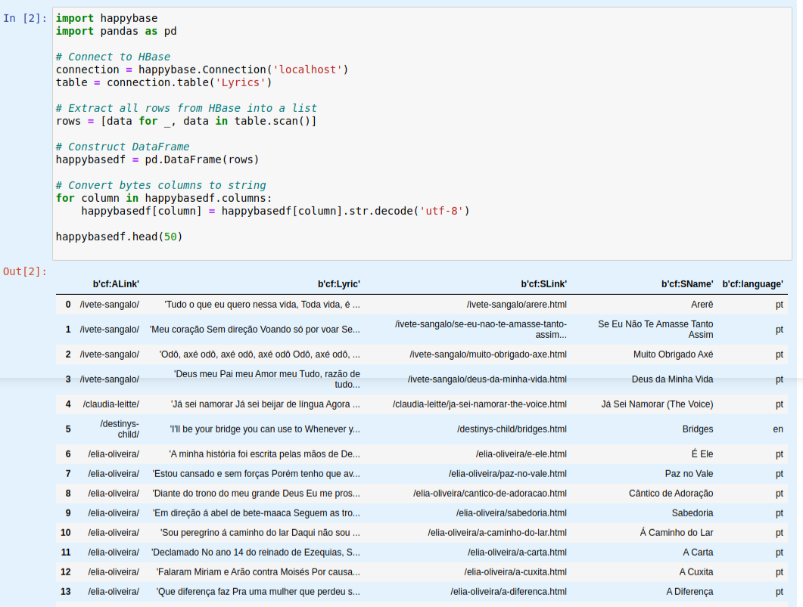

Slide 15
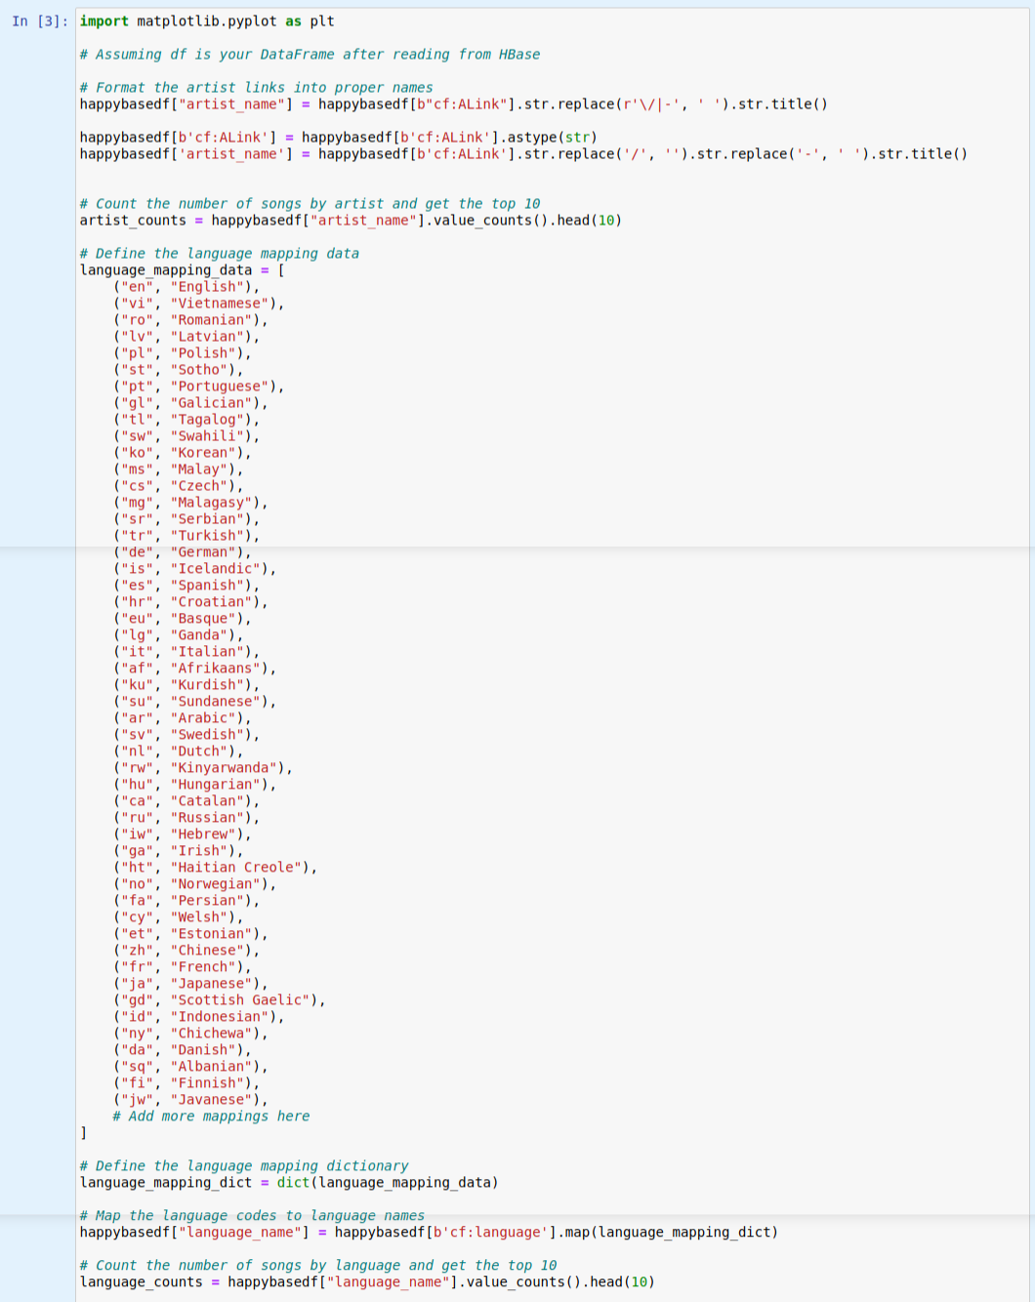

Slide 16
